Slide 1

Product Development & Improv
A Zactice Talk
Notes:
Why is Zach qualified to give this talk:
One year of improv in Charleston at Theatre 99
Running multiple product teams, co-located & global
Intrapreneuership
Thought leader in the transformation and product space

Slide 2
WHAT TO LEAVE WITH
Discover something new- make a connection you have never made before
The motivation to individually or as a team experiment with improv classes as a means to work better
Be entertained

Slide 3
Notes:
Imagine you are looking through a dark window and all you see is a pinhole of light.

Slide 4


THE BEGINNING
Improv
Product
An empty canvas…. And there is no script
Start with a word
“Racecar Driver”
Start with a problem
“I need to travel long distances”
Methodology
Organized chaos
Things start to reveal themselves
Notes:
Improv
All you know and the audience know is the “thing”
My first scene ever, the word I had to make a scene about was actually racecar driver
Product
All you and the team know is a pain point or opportunity
Boeing as a company could be said to be solving long range high speed travel as a problem area

Slide 5
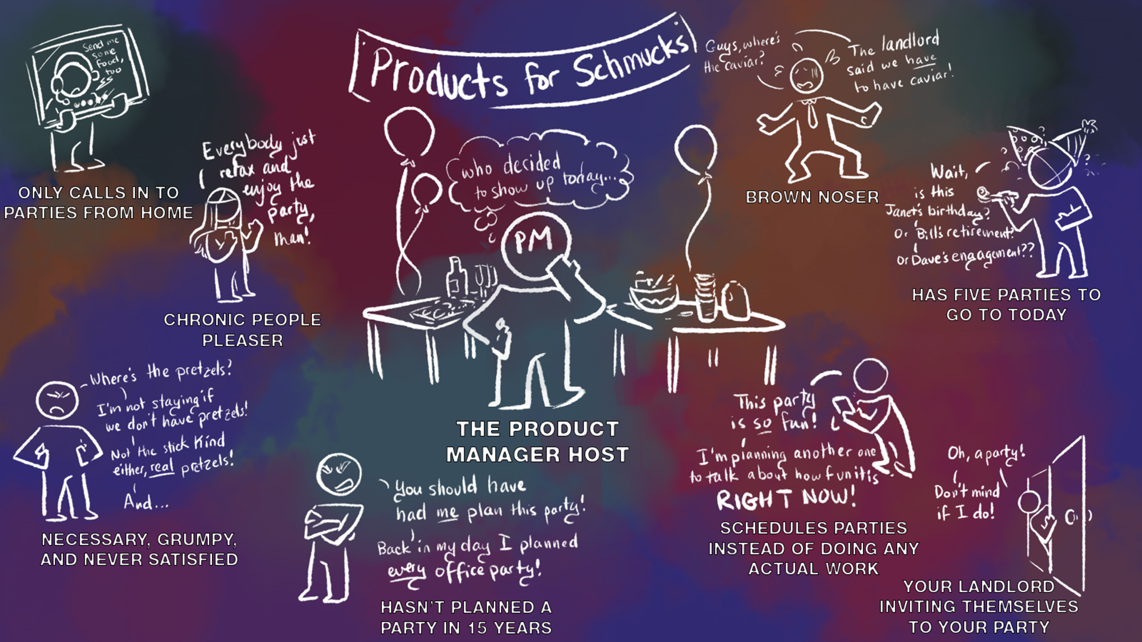

Slide 6


EMPATHY
Improv
Product
Who are you to me?
Remain open and empathetic
Your team has no idea what you guys should build
What do these people think they want?
Your partner has no idea what you want to create
How can I find the implied meaning?
Notes:
Product
You have to keep in mind that the whole product team needs to be on the same page and the things you learn need to be shared
I use confluence to share research and insights
When interviewing, lead with openness you might learn something
Improv
One time I started a scene knowing I was going to be a bouncer outside a bar… I just forgot to let my partner know
You have to have empathy with your partner until you get footing

Slide 7


Slide 8


DISCOVERY
Improv
Product
Time here pays dividends
Learn as you go
Person by Person you interview your users to understand the market
Focus on what you are trying to accomplish
Line by line you build a scene with your partner
Don’t be scared of something you don't expect
Notes:
Product
employee community fund- didn’t interview users- stakeholders drug out the build and didn’t know what they wanted
6 pillars- interviewed all directors- learned where they go for info, whats important to them, their goals
Problem reframing- what do you want, and if you had XX then what would it give?
Improv
Scene with Nathan in a prison cell. Started I thought I was in a kitchen- turned out I was in a prison cell

Slide 10


YES…. AND
Improv
Product
Not “no….but”
“Hey I think we should add golden toilets to our airplanes”
Yes and when building a scene
Options
Yes and when brainstorming
“Yes and it will add a lot of cost and weight to our airplanes which could have negative effects but it will be luxurious"
Notes:
Improv
Scene where I was interviewing guy for a job and he just answered with one word. Killed me and the scene
Product
Opportunity solution tree with caroll and Ajmal for AMOS. We wanted to present them OPTIONS of things to try

Slide 12


CO-CREATION
Improv
Product
They participate in form of giving suggestions for scenes
They participate in the form of focus groups and interviews
You build together
The Audience is your customer
Your end user is your customer
By participating, you care more about the outcome
Notes:
Product
When working on a solution for keeping security compliance of computing assets on the factory floor- Interview the engineers managing those devices. They have a say and only then will they use it
Improv
When the audience contributed with a bunch of suggestions, they feel part of the show

Slide 14


BE SPECIFIC
Improv
Product
“I'm having dinner at a restaurant”
“We are sitting at Benihana and I'm scared I cant catch the shrimp in my mouth and there's a flaming volcano”
Vivid stories
Keeping outcomes, features, and metrics specific leads to better products
Specificity is improv gasoline on a fire
Clear user stories help convey clear value
Notes:
Improv
Scene when directing a movie vs. an action movie in the woods during an explosion scene and the fourth installment
Product
I want a way to select things vs. I want a way to compare two icons next to each other with various color choices so I can see which would be a better fit for my presentation

Slide 16


FLOW
Improv
Product
Rhythm
You know who you are, where you are, and what you are doing!
Build build build!
You know the market you are serving, their pain relievers and gain creators
Fit
Trust is at an all time high
Notes:
Product
Product market fit
Improv
Scene fit
EVERYONE knows when you have it. Theres traction and its FUN

Slide 18


FEEDBACK
Improv
Product
They give you feedback in laughter… or silence
You learn from your market
They give you feedback in suggestions or reviews
The audience has a say whether you ask or not
Customers vote with their fingers and wallets
If you aren’t getting downloads, customers, or dollars you should probably re-evaluate your product
Notes:
Product
People are contacting you with questions
You start monitoring behavior like heat patterns how long people spend using your product
You parse through text reviews for trends to make improvements
Improv
Silence is deafening up there
Laughs fuel the scene
You know when things are landing and you press down that path

Slide 20


PRIORITIZE THE WHOLE
Improv
Product
When your customer wins you win
Scene success first over individual glory at the expense of your partner
Team first always
Product team success first over individual success
I've got your back
Time for the next adventure!

Slide 22
SUMMARY
ATTRIBUTES
INTERSECTIONS
The Beginning
Organized Chaos
Empathy
Remain Open and Empathetic
Discovery
Learn as you Go
Yes…And
Options
Co-Creation
You Build Together
Be Specific
Vivid Stories
Flow
Build Build Build!
Feedback
You Learn From Your Market
Prioritize the Whole
Team First Always

Slide 23
TAKEAWAYS
Building products is really just an improv exercise
The second its not about you, the better things go
I no longer have a design handicap
Drawing by Caroline Cash
Icons by Freepik

Slide 24
A GIFT
5 Improv games you can do with your team
The second its not about you, the better things go

Slide 25
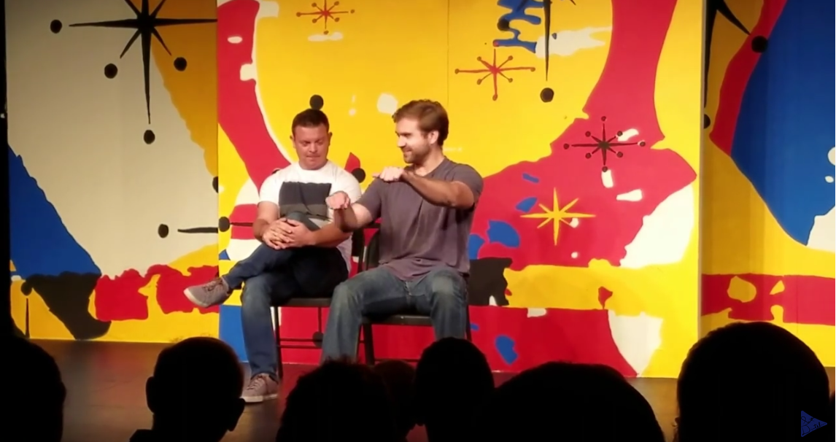

Slide 26
